Slide 1
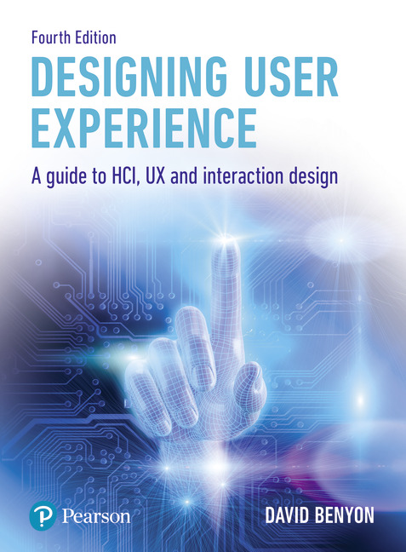
Designing User Experience
A guide to HCI, UX and Interaction Design
Fourth Edition
Chapter 3
The process of human-centred UX design

Slide 2
Contents
3.1 Introduction
3.2 The process of UX design
3.3 Developing personas
3.4 Developing scenarios
3.5 Using scenarios throughout design
3.6 A scenario-based UX design method
3.7 Case study. Secret City: Edinburgh

Slide 3
Overview
Design is a creative process concerned with bringing about something new.
It is a social activity with social consequences.
It is about conscious change and communication between designers and the people who will use the system.
Different design disciplines have different methods and techniques for helping with this process.
Approaches to and philosophies of design change over time.
In mature disciplines, examples of good design are built up and people can study and reflect upon what makes a certain design great, good or awful.
Different design disciplines have different constraints such as whether the designed object is ‘stand alone’ or whether it has to fit in and live with legacy systems or conform to standards.
UX is increasingly concerned with both the moments of interaction and how experiences unfold over time.

Slide 4
Aims
Understand the nature of UX design
Understand the four processes involved in design: understanding, design, envisionment, evaluation
Understand the centrality of evaluation in human-centered design
Understand the centrality of evaluation to human-centred UX
Understand the use of personas in UX
Understand the use of scenarios in UX
Be able to use scenarios throughout the UX design process

Slide 5
Introduction
There are many different ways of characterizing the activities involved in the design process.
For David Kelley, founder of the product design company IDEO:
‘Design has three activities: understand, observe and visualize’.
‘Remember, design is messy; designers try to understand this mess. They observe how their products will be used; design is about users and use. They visualize which is the act of deciding what it is’.
Another popular characterization of the UX design process is the ‘double diamond’ model developed by the Design Council (UK).
This characterizes the design process in terms of four processes: discover, define, design and deliver.

Slide 6
PACT and design
In order to guide the design process, designers need to think about the PACT elements (introduced in Chapter 2).
The people who will use the system are represented by personas: profiles of the different types, or archetypes, of people the designer is designing for.
Activities and the contexts in which they will occur are envisioned through scenarios of use.
Different concrete scenarios can be used to envision how different technologies (hardware and software) could function to achieve the overall purpose of the system and deliver a good UX.
Personas and scenarios are developed early in the design process, using any of a wide range of methods of understanding and ideation and through undertaking a PACT analysis.
Almost inevitably, personas and scenarios evolve together as thinking about people involves thinking about what they want to do, and thinking about activities involves thinking about who will be undertaking them!

Slide 7
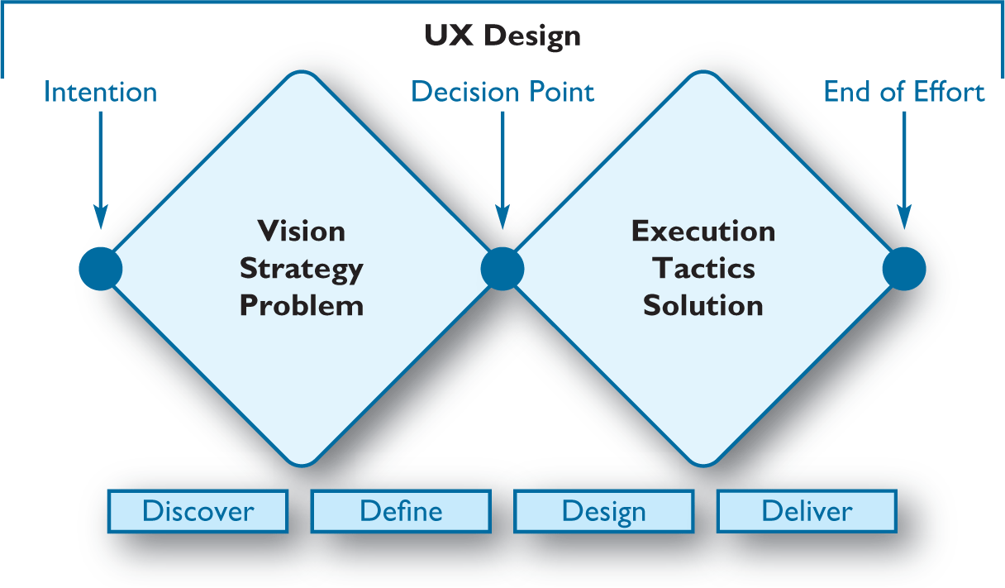
Figure 3.1
The double diamond model

Slide 8
Our view of UX design
We characterize the overall design process in terms of the four activities understanding, envisionment, design and evaluation:
Evaluation is central to designing interactive systems. Everything gets evaluated at every step of the process.
The process can start at any point – sometimes there is a conceptual design in place, sometimes we start with a prototype and sometimes we start with requirements.
The activities can happen in any order, for example requirements might be evaluated, a prototype might be built and evaluated and some aspect of a physical design might then be identified.
Notes:
Figure 3.2 Understanding, design, evaluation, envisionment

Slide 9
Understanding
Understanding is concerned with what the system has to do, what it has to be like and how it has to fit in with other things, with the requirements of the product, system or service.
Designers need to research the range of people, activities and contexts relevant to the domain they are investigating so that they can understand the requirements of the system they are developing.
They need to understand the opportunities and constraints provided by technologies.

Slide 10
Requirements
There are both functional and non-functional requirements to consider.
Functional requirements are concerned with what the system should be able to do and with the functional constraints of a system.
It is important for the designer to think about the whole interaction experience in an abstract way.
Deciding who does what, when something should be displayed or the sequence in which actions are undertaken should come later in the design process.
A good analysis of an activity will strive to be as independent of current practice as possible.
Of course, there are always functional constraints – the realities of what is technically possible – which render certain ordering, sequencing and allocation of functions inevitable.
There are also logical and organizational constraints that may make particular designs infeasible.

Slide 11
Defining requirements
Requirements are generated through discussions and interactions with people who will use or be affected by the proposed system, the stakeholders.
Requirements are also generated through observations of existing systems, research into similar systems, what people do now and what they would like to do.
Requirements can be generated through working with people in focus groups, design workshops and so on, where different scenarios can be considered.
The aim is to collect and analyse the stories people have to tell. Requirements are essentially about understanding.

Slide 12
Stakeholders
Stakeholders is a term that refers to all the people who will be affected by any systems that results from the process of interactive systems design.
This includes the people who will finish up using the new system (sometimes called the ‘users’) but it also includes many other people.
For example, the organization that the system is being designed for will probably have many people in it that will not be using the system but will be affected by it as it might change their job.
There may be stakeholders outside the organization such as government authorities that need to verify some procedures.
The number and type of people affected by a new interactive system will vary greatly according to what sort of system it is.
An important part of the understanding process is to consider all the different stakeholders and how they might be affected and to decide who should be involved in discussions about the design.

Slide 13
Conceptual design
Design activities concern both conceptual design and physical design.
Conceptual design is about designing a system in the abstract and physical design is concerned with making things concrete.
Conceptual design is about considering what information and functions are needed for the system to achieve its purpose.
It is about deciding what someone will have to know to use the system.
It is about finding a clear conceptualization of a design solution and how that conceptualization will be communicated to people (so that people will quickly develop a clear mental model).
The key feature of conceptual design is to keep things abstract – focus on the ‘what’ rather than the ‘how’ – and to avoid making assumptions about how functions and information will be distributed.
There is no clear-cut distinction between conceptual and physical design but rather there are degrees of conceptuality.

Slide 14
Techniques to help with conceptual design
Software engineers prefer modeling possible solutions with objects, relationships and ‘use cases’ (a semi-formal scenario representation).
Entity–relationship models are another popular conceptual modeling tool.
Flow can be represented using dataflow diagrams and structure can be shown with structure charts.
The conceptual design of a website, for example, will include a site map and a navigation structure.
Many different conceptual models are used in the contextual inquiry method.

Slide 15
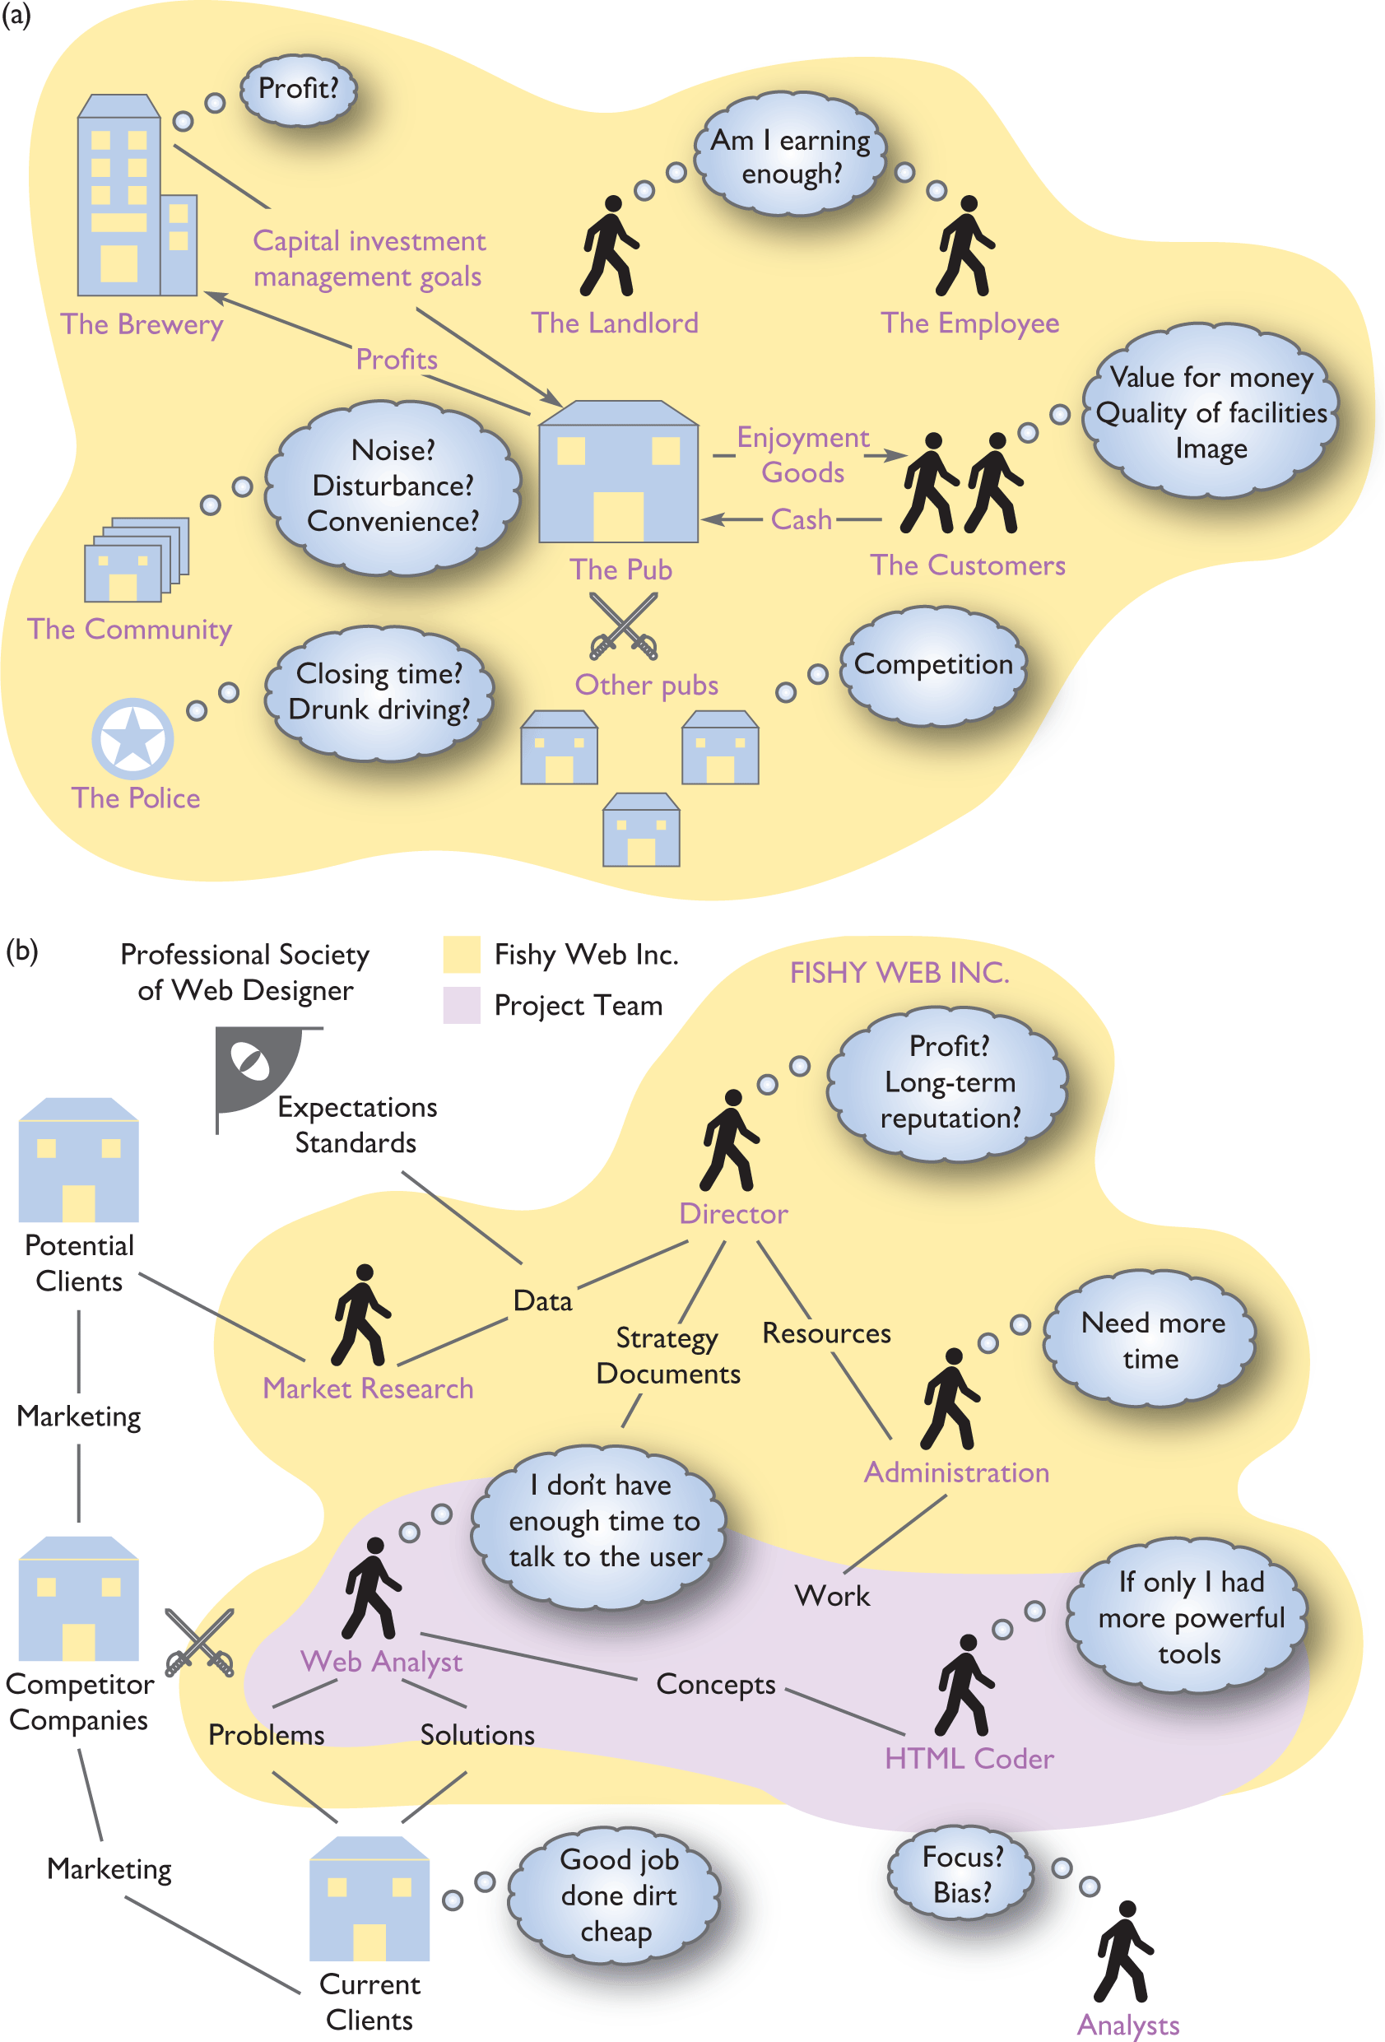
Rich Pictures (1 of 2)
Source: After Monk, A. and Howard, S. (1998) Methods & Tools: the rich picture: a tool for reasoning about work context, Interactions , 5(2), pp. 21–30. © 1998 ACM, Inc. Reprinted by permission
Notes:
Figure 3.3
Rich pictures of (a) a pub and (b) a web design company

Slide 16
Rich Pictures (2 of 2)
A rich picture captures the main conceptual relationships amongst the main conceptual entities in a system – a model of the structure of a situation. Peter Checkland, who originated the soft systems approach, also emphasizes focusing on the key transformation of a system.
The principal stakeholders – customers, actors and system owners – should be identified.
The designer should also consider the perspective from which an activity is being viewed as a system (the Weltanschauung) and the environment in which the activities take place.
Checkland proposes the acronym CATWOE – customers, actors, transformation, Weltanschauung, owners, environment – for these elements of a rich picture.
Most importantly, the rich picture identifies the issues or concerns of the stakeholders, thus helping to focus attention on problems or potential design solutions.

Slide 17
Physical design
Physical design is concerned with how things are going to work and with detailing the look and feel of the product.
Physical design is about structuring interactions into logical sequences and about clarifying and presenting the allocation of functions and knowledge between people and devices.
The distinction between conceptual and physical design is very important.
The conceptual design relates to the overall purpose of the whole interactive system.
Between the people and the technologies, there has to be enough knowledge and ability to achieve the purpose.
Physical design is concerned with taking this abstract representation and translating it into concrete designs.
On one side this means requirements for hardware and software and on the other side it defines the knowledge, tasks and activities that people will be required to do.
The three components are operational design, representational design and design of interactions.

Slide 18
Operational design
Operational design is concerned with specifying how everything works and how content is structured and stored.
Taking a functional view of an activity means focusing on processes and on the movement, or flow, of things through a system.
Events are occurrences that cause, or trigger, some other functions to be undertaken.
Sometimes these arise from outside the system under consideration and sometimes they arise as a result of doing something else.
For example, some activity might be triggered on a particular day or at a particular time.
Another might be triggered by the arrival of a person or document.

Slide 19
Representational design
Representational design is concerned with fixing on colours, shapes, sizes and information layout.
It is concerned with style and aesthetics and is particularly important for issues such as the attitudes and feelings of people but also for the efficient retrieval of information.
Style concerns the overall ‘look and feel’ of the system.
Does it appear old and ‘clunky’ or is slick, smooth and modern? What mood and feelings does the design engender?
For example, most Microsoft products engender an ‘office’ and ‘work’ mood, serious rather than playful.
Many other systems aim to make the interaction engaging, some aim to make it challenging and others entertaining.
In multimedia and game applications, this is particularly important.

Slide 20
Interaction design
Interaction design, in this context, is concerned with the allocation of functions to human agency or to technology and with the structuring and sequencing of the interactions.
Allocation of functions has a significant impact on how easy and enjoyable a system is to use.
Designers create tasks for people by the way they allocate functions.
For example, consider the activity of making a phone call. Conceptually speaking, certain functions are necessary: indicate a desire to make a phone call, connect to the network, enter the phone number and make connection.
Years ago a telephone exchange was staffed by people and it was these people who made connections by physically putting wires into connectors.
In the days of wired phones, picking up the receiver indicated the desire to make a call, the full number had to be dialed in and then the telephone exchange would automatically make the connections.
Nowadays a person just has to press the connect button on a cellular phone, choose someone’s name from the phone’s address book and the technology does the rest.
Recall the activity-technology cycle discussed in presentation 2.
The allocation of knowledge and activities between people and technologies is a significant part of how experiences change over time.

Slide 21
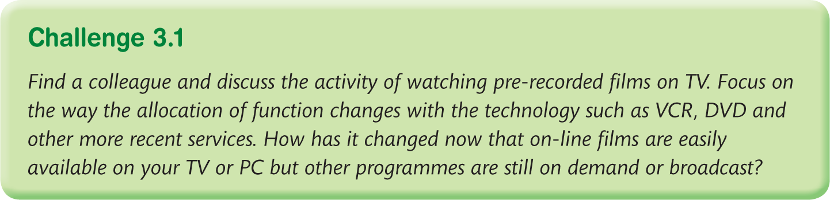

Slide 22
Envisionment
Designs need to be visualized both to help designers clarify their own ideas and to enable people to evaluate them.
Envisionment is concerned with finding appropriate media to render design ideas.
The medium needs to be appropriate for the stage of the process, the audience, the resources available and the questions that the designer is trying to answer.
There are many techniques for envisionment but they include any way in which abstract ideas can be brought to life.
Sketches ‘on the back of an envelope’, fully functioning prototypes and cardboard mock-ups are just some of the methods used.
Scenarios, sometimes represented in pictorial form as storyboards, are an essential part of prototyping and envisionment.
They provide a way of working through a design idea so that the key issues stand out.

Slide 23
Evaluation
Evaluation is tightly coupled with envisionment because the nature of the representation used will affect what can be evaluated.
The evaluation criteria will also depend on who is able to use the representation.
Any of the other design activities will be followed by an evaluation.
Sometimes, this is simply the designer checking through to make sure something is complete and correct.
It could be a list of requirements or a high-level design brief that is sent to a client, an abstract conceptual model that is discussed with a colleague or a formal evaluation of a functional prototype by the future system users.
Techniques for evaluation are many and various depending once again on the circumstances.
The important thing to keep in mind is that the technique used must be appropriate for the nature of the representation, the questions being asked and the people involved in the evaluation.

Slide 24
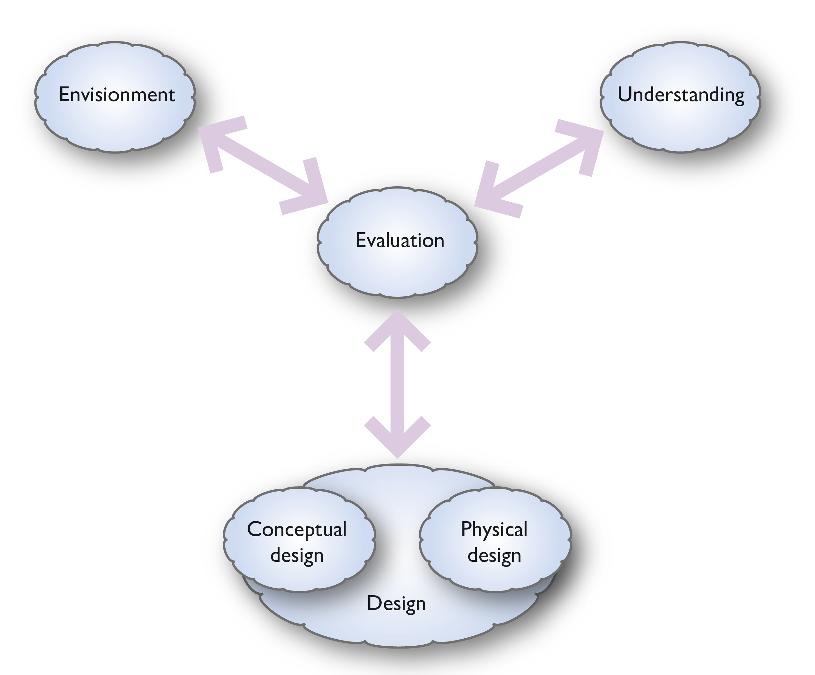
Notes:
Figure 3.2
Understanding, design, evaluation, envisionment

Slide 25
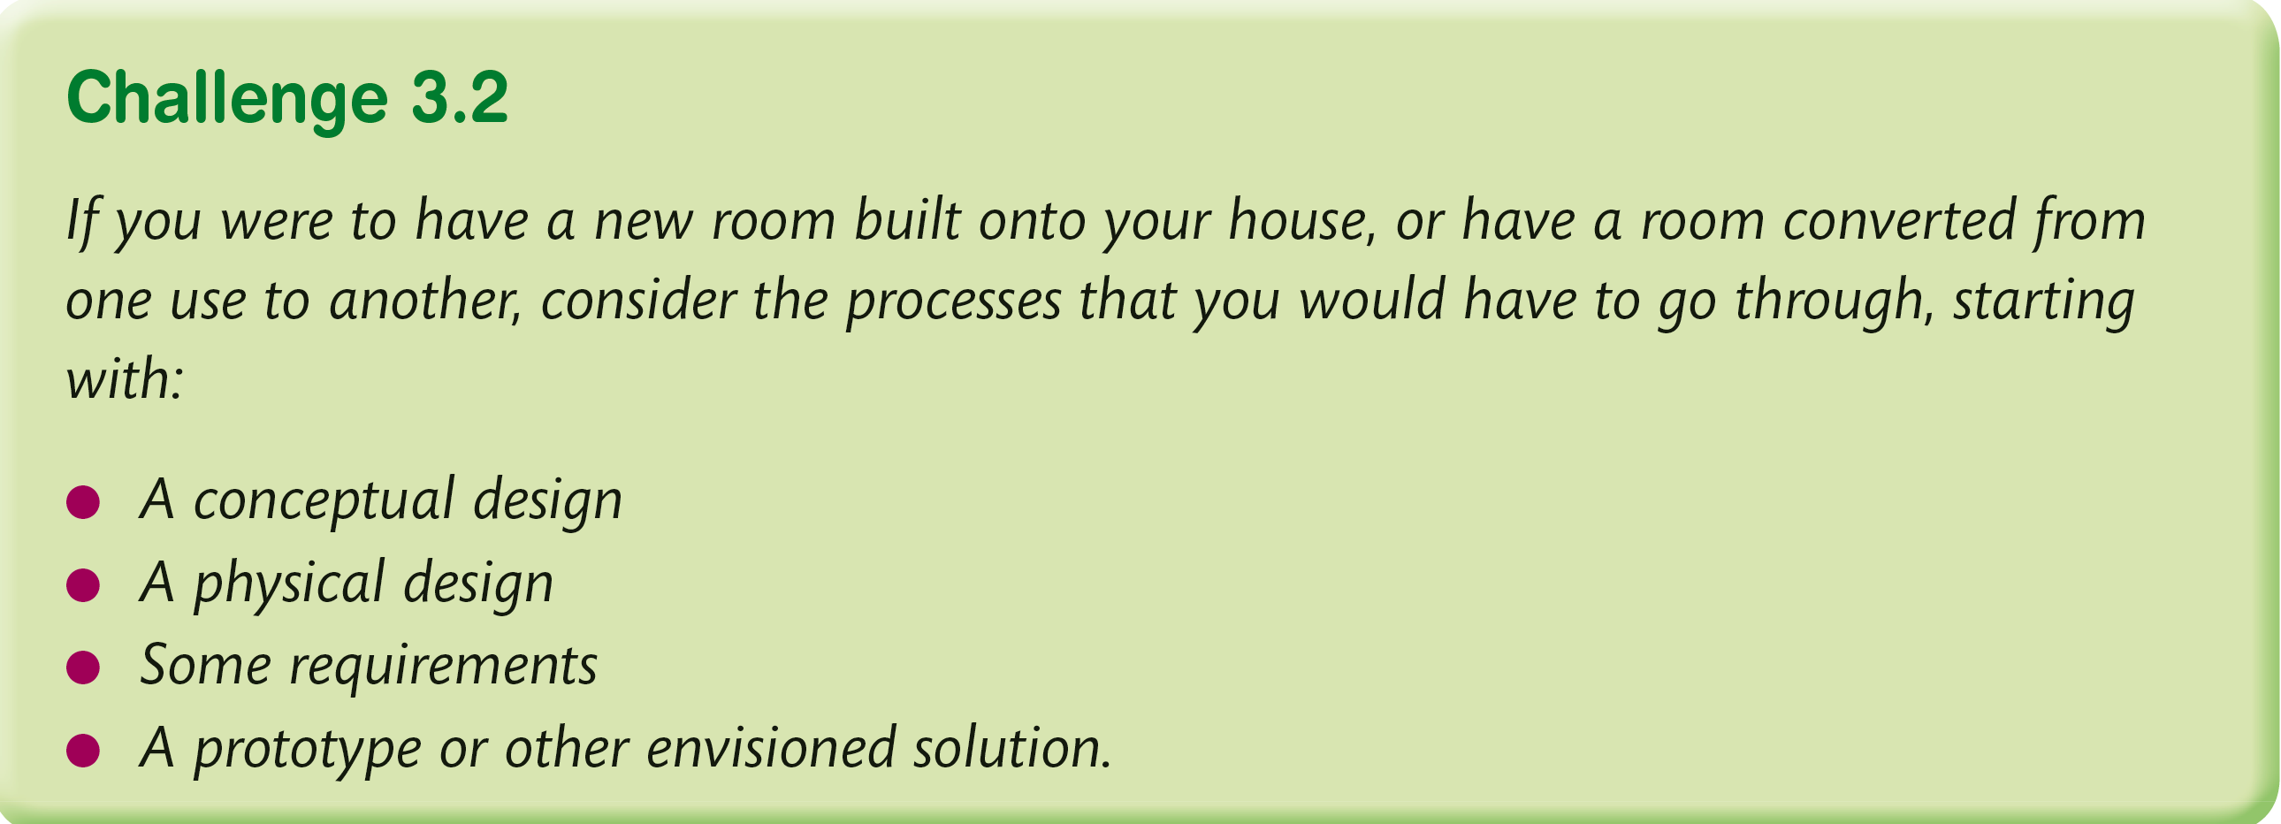

Slide 26
Implementation
Ultimately, things have to be engineered and software has to be written and tested.
Databases have to be designed and populated and programs have to be validated.
The whole system needs to be checked to ensure that it meets the requirements until finally the system can be formally ‘launched’ and signed off as finished.
Clients will often want extra features when they see a system nearing completion but these will have to be costed and paid for.
On the other hand, the developers need to ensure that their system really does meet the specification and does not contain any ‘bugs’.
If interactive systems designers were architects, they would have well-understood methods and conventions for specifying the results of the design process.
They would produce various blueprints from different elevations and engineering specifications for particular aspects of the design.
In interactive systems design, there are a variety of formal, semi-formal and informal methods of specification.

Slide 27
UX and formal methods
If UX designers were architects, they would have well-understood methods and conventions for specifying the results of the design process.
They would produce various blueprints from different elevations and engineering specifications for particular aspects of the design.
In UX, there are a variety of formal, semi-formal and informal methods of specification.
The best known of the formal methods is the Unified Modeling Language (UML) (Pender, 2003).
Over the past few years, there has been a move away from large software engineering approaches to the development of interactive systems towards ‘agile’ development methods.
These are designed to produce effective systems of high quality that are fit for purpose but without the huge overhead associated with the planning and documentation of a large IT (information technology) project.

Slide 28
Agile development
There are a number of competing methods for agile development.
Probably the best known comes from DSDM, a not-for-profit consortium of software development companies.
Their system, called Atern, is fully documented, showing how software can be developed in small teams.
Another is eXtreme programming (XP, Beck and Andres, 2004).
However, in reality, most organizations develop their own version of agile development.

Slide 29
An agile approach
The approach is aimed at design teams developing interactive services or products.
A project will be divided into manageable periods of work (typically 2 weeks long) known as ‘sprints’.
Meetings of the design team are held at the beginning of each week in order to agree what should be produced during the sprint and to measure progress. These ‘scrums’ or ‘huddles’ are intended to develop a good team spirit and to ensure that everyone knows what they should be doing and what other members of the team are doing.
The aim is to quickly produce a minimum viable product (MVP).
This is a version of the product or service that does just enough to meet its purpose.
It can then be evaluated and tested by users.
This may result in further development or it becomes version 1 of the product or service.
Additional features can be added through further developments and subsequent versions can be developed and deployed.
Indeed, it is quite common in interaction design for regular updates of an app or web service to be produced over time.
Agile development methods are quite compatible with the four activities in our design process and with the approach based on developing scenarios and personas.
Notice the central feature of evaluation to the process and on developing an MVP that allows the designers to experiment and test their design ideas and assumptions.

Slide 30
Developing personas
Personas are concrete representations of the different types of people that the system or service is being designed for.
Alan Cooper introduced the idea of personas in the late 1990s (Cooper, 1999) and they have gained rapid acceptance as a way of capturing knowledge about the people the system or service is targeted at.
In a later edition of his book (Cooper et al., 2007), he links personas very closely with his ideas of goal-directed design.
Personas want to be able to do things using your system.
They want to achieve their aims.
They want to undertake meaningful activities using the system or service that the designer will produce.

Slide 31
Using personas (1 of 2)
In the development of personas, it is important to include the aspirations of potential users as well as looking at more functional aspects.
Personas should help shape the whole UX and people will have an emotional response to a product or service as well as a response based on pragmatic qualities.
Thus, designing for pleasure is important and the UX designer needs to consider the hedonic qualities of products and services.
Designers also need to recognize that they are not designing for themselves.
Designers create personas so that they can envisage whom they are designing for.
They create personas so that they can put themselves in other people’s shoes.

Slide 32
Using personas (2 of 2)
As any new system is likely to be used by different types of people, it is important to develop several different personas.
For example, in designing a website for people interested in the author Robert Louis Stevenson (described in more detail in Chapter 14), we developed personas for a school teacher in Germany, a university lecturer from the United Kingdom, a child in Africa and a Stevenson enthusiast from the United States of America.
Such a diverse group of people have very different goals and aspirations and differ in all the ways we discussed when discussing PACT – physically, psychologically and in terms of the usage they would make of the site (see Chapter 2).

Slide 33
Defining personas
There is no agreed standard for defining and documenting personas.
Cooper et al. (2007) emphasize the different types of goals that people have — experience goals, end goals and life goals — that should be represented in the personas that are developed.
By looking at the variety of these (as we suggest looking at the variety through PACT analysis), designers can identify the various behavior patterns that different personas may demonstrate.
There is a very good in-depth treatment of personas by Pruitt and Aldrin (2006) and some excellent advice and useful templates from a number of practitioners.
There are many templates promoted by UX design agencies freely available on the internet. The one shown in Figure 3.4 is taken from Mattias Arvola.

Slide 34
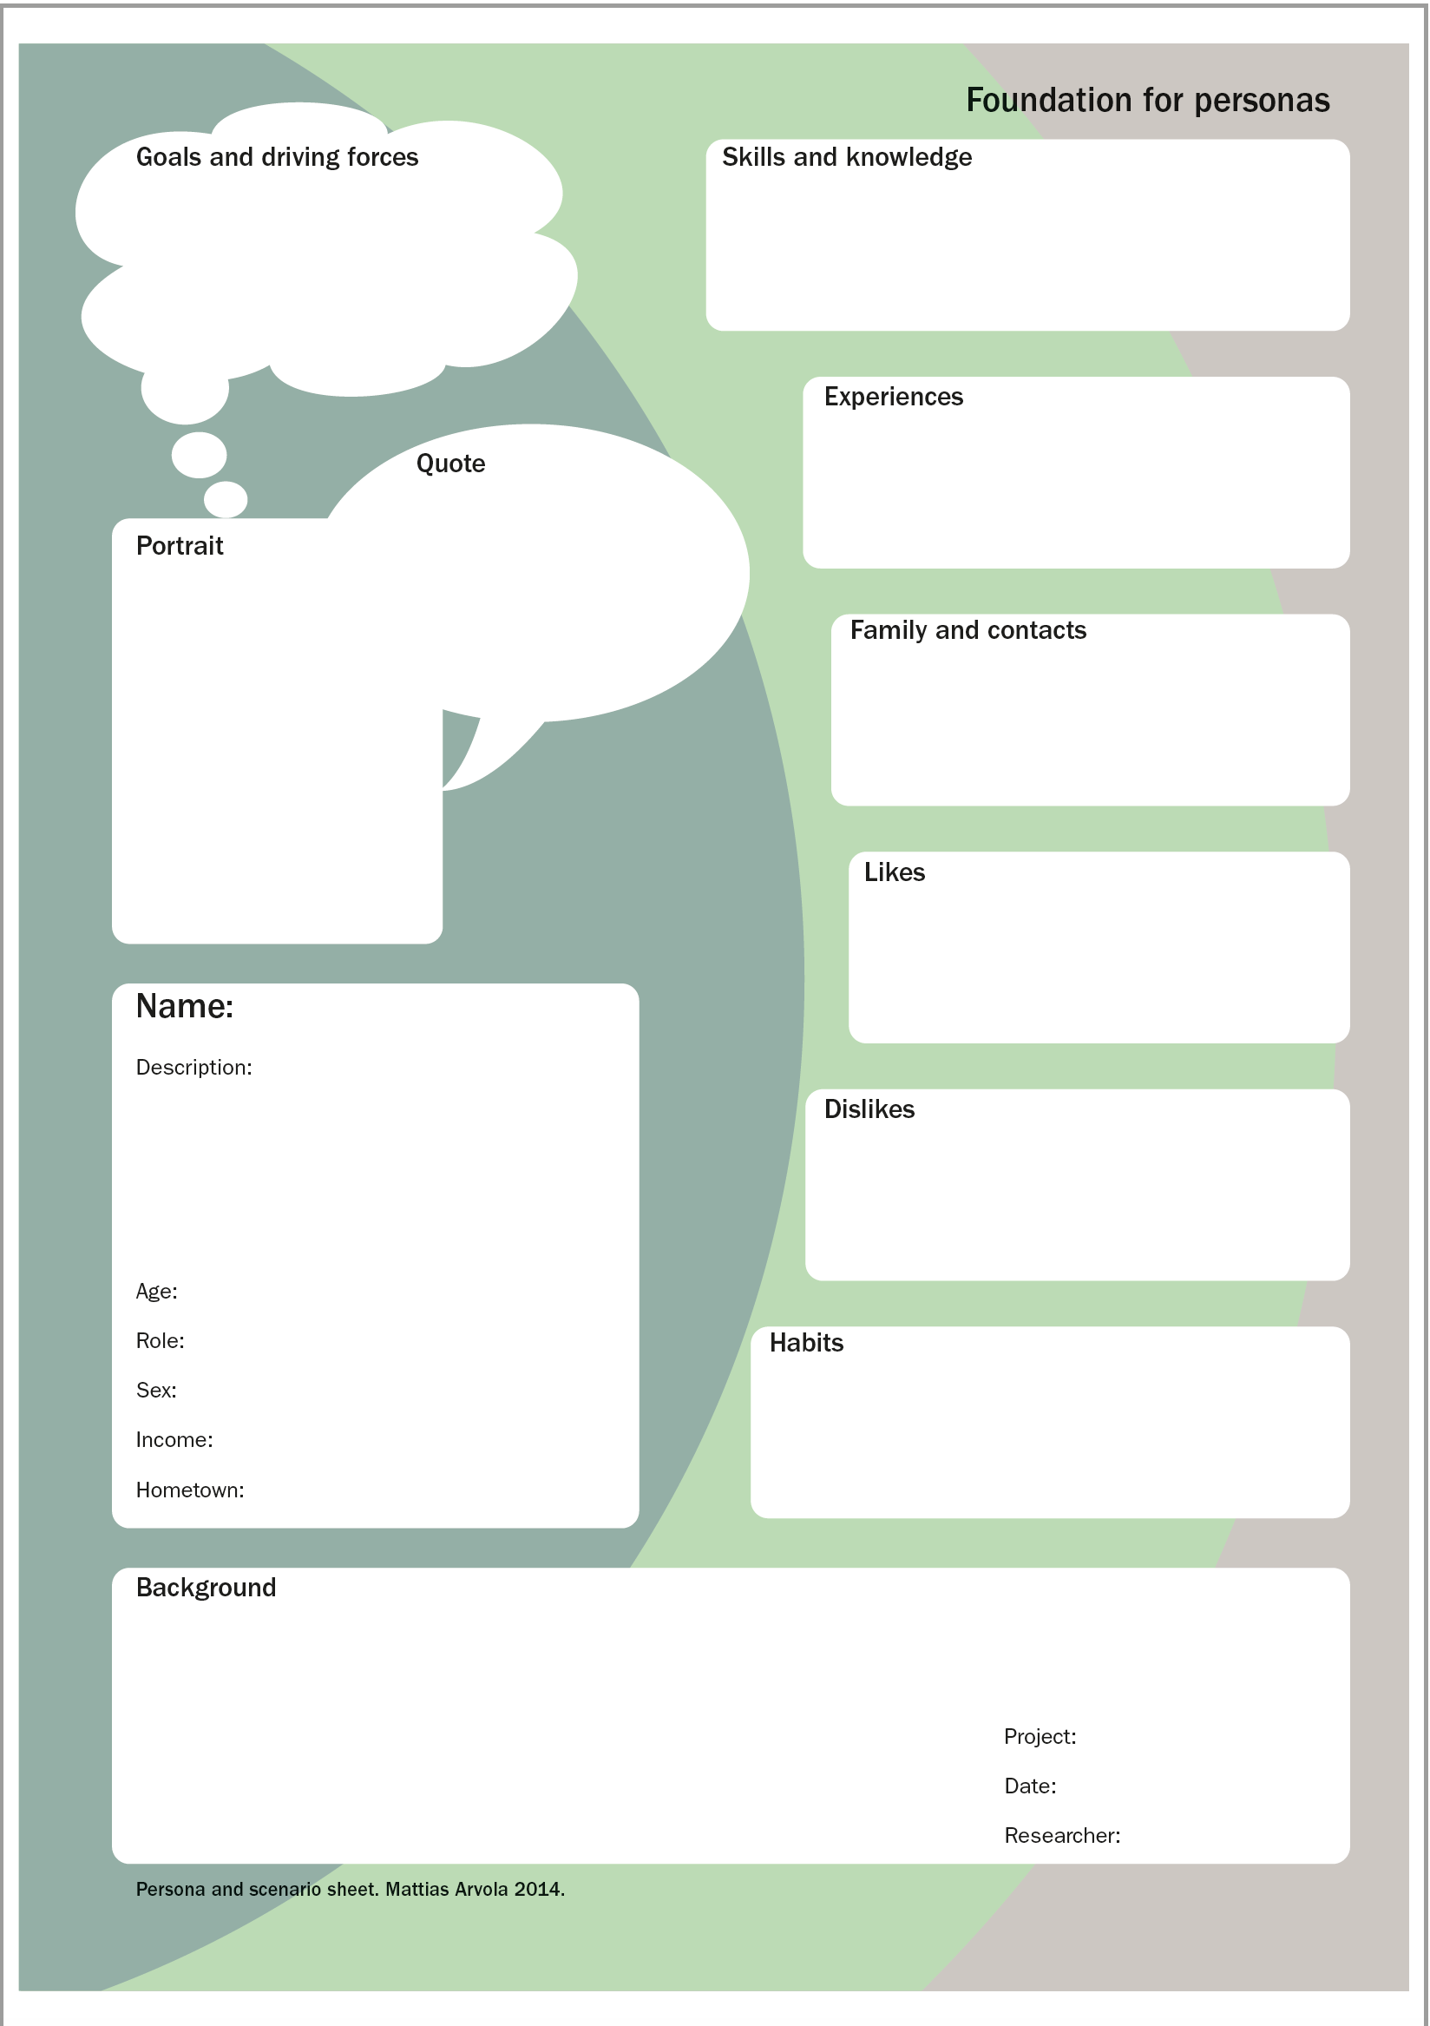
Example persona template
Notes:
Figure 3.4 A persona template

Slide 35
Critiquing personas
Of course, the use of personas is not without its critics and it is important that designers do not fall foul of simply creating stereotyped personalities or create personas that are just like themselves or their ideal partner!
Persona development should be agile and subject to change and should focus on the UX aspects of interaction, rather than other aspects such as marketing.
In our examples here, the personas include snippets of the main scenarios (see section 3.3).
As we said earlier, it is difficult to think about personas without thinking about what activities they might want to do and why they want to do them.

Slide 36
Example: Companions
We have recently been looking at a novel form of interaction that goes under the title of ‘Companions’.
Companions are seen as an intelligent, personalized, multimodal, interface to the internet.
Companions know their ‘owners’ and adapt the interaction to personalized interests, preferences and emotional state.
In investigating the companions concept, we have developed a number of persons and scenarios.
A Health and Fitness companion, for example, would help provide advice and companionship for people in the domain of health and fitness.
We explored the idea in a two day workshop attended by a number of the project partners.
During and subsequent to this workshop, two personas were developed to explore the various needs of people with differing lifestyles, levels of fitness and exercise regimes.
In another exploration, we looked at the concept of a companion to deal with digital photos. Such a companion would be functional in helping organize, edit and share photos but would also be a conversational partner.

Slide 37
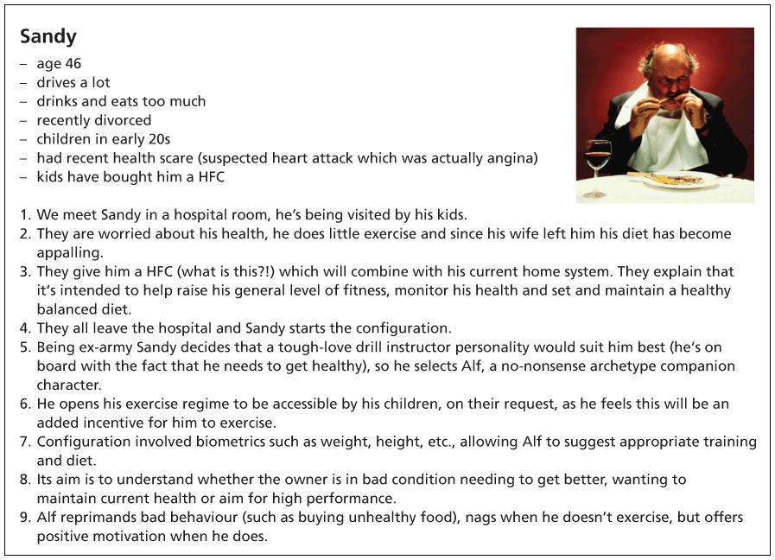
Notes:
Figure 3.5 The Sandy persona for HFC scenario

Slide 38
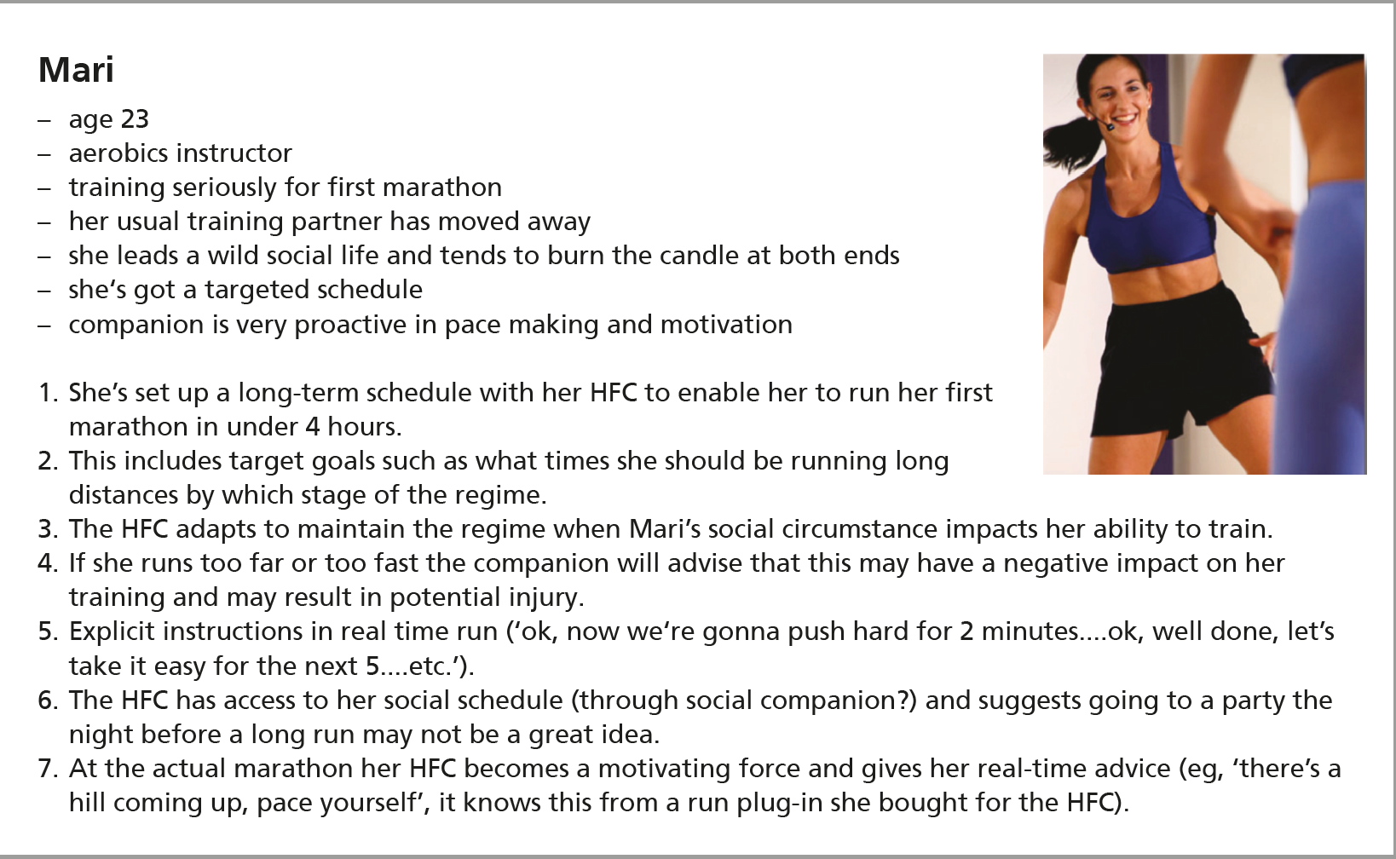
Notes:
Figure 3.6 The Mari persona for HFC scenario

Slide 39
Developing scenarios
Scenarios are stories about people undertaking activities in contexts using technologies.
They appear in a variety of forms throughout interactive systems design and are a key component of many approaches to design.
Scenarios have been used in software engineering, interactive systems design and human–computer interaction work for many years.
More recently, scenario-based design has emerged as an important approach to the design of interactive systems in the twenty-first century.
One of the main proponents of scenario-based design is John Carroll and his book Making Use remains an excellent introduction to the philosophy underlying the approach.
In it he illustrates how scenarios are used to deal with the inherent difficulty of doing design.

Slide 40
Five key problems of design (from Carroll)
The external factors that constrain design are time constraints, lack of resources, having to fit in with existing designs and so on.
Design moves have many effects and create many possibilities, that is, a single design decision can have an impact in many areas and these need to be explored and evaluated.
How scientific knowledge and generic solutions lag behind specific situations? This point concerns generalities. In other design disciplines, general design solutions to general design problems have evolved over the years. In interactive systems design, this does not happen because the technology changes as soon as, or even before, general solutions have been discovered.
The importance of reflection and action in design is also a concern.
The slippery nature of design problems needs to be considered.

Slide 41
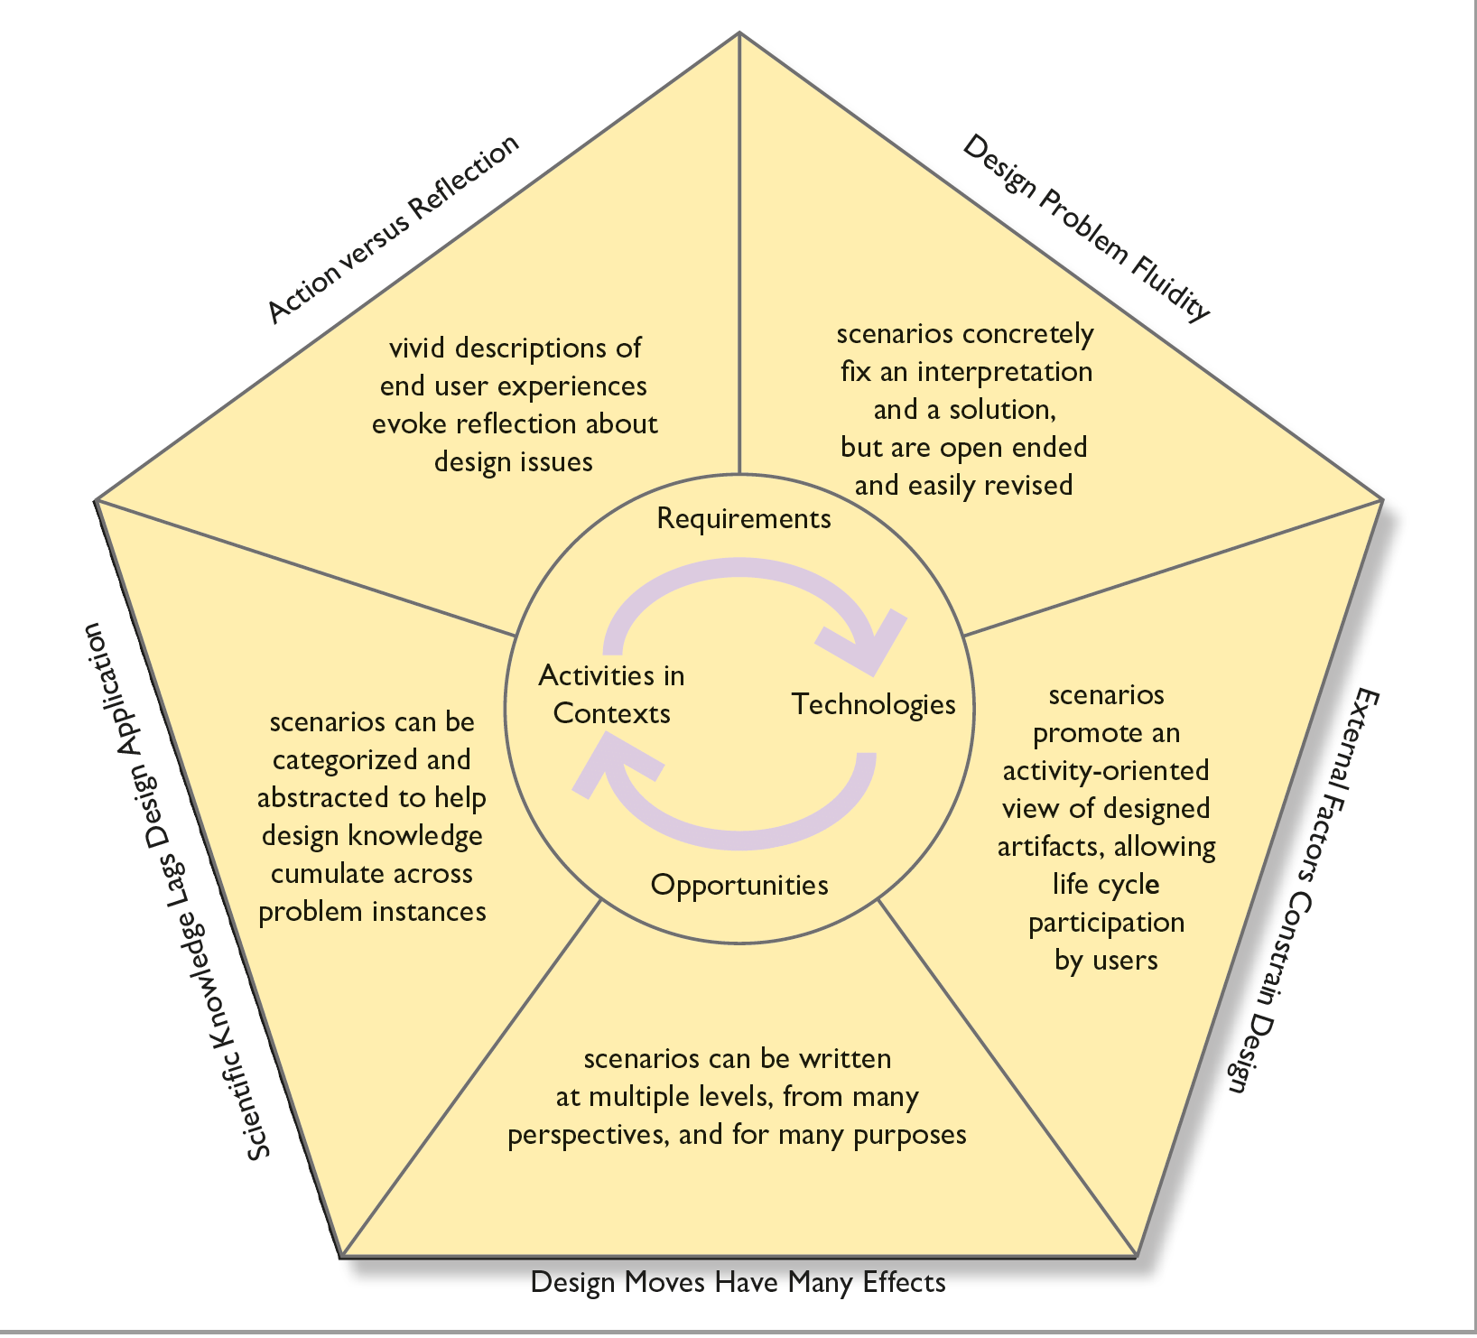
Figure 3.7
Challenges and approaches in scenario-based design
Source: After John M. Carroll. Making Use: Scenario-based Design of Human-Computer Interactions. Fig. 3.2, p. 69 © 2000 Massachusetts Institute
of Technology, by permission of The MIT Press

Slide 42
Motivations
One central theme of the explorations concerned the motivational approaches that would be suitable for different scenarios and personas.
The Sandy persona would need more encouragement and persuasion to exercise than the Mari persona perhaps by preventing a recorded television program from being shown until training is completed.
Another aspect, concerning social networking, was explored through the Bjorn persona.
Thus the personas were developed to reflect particular design issues and values.
The whole issue of persuasion technologies is a difficult one for interaction design.

Slide 43
Captology
The basic aim of captology is to persuade people to do things they otherwise would not do.
Who are we, as designers, to persuade people to do something they don’t want to do.
However, we can see examples, such as the Sandy persona, where persuading him to exercise is for his own good.
We also need to persuade people to take precautions if things are dangerous.
I am quite happy that a software system persuaded me to save my work before the system crashes (on the other hand why did the system not just save it for me?).
Persuasion is ‘a non-coercive attempt to change attitudes or behaviors of people’ (Fogg, Cuellar and Danielson, 2008).
However, if this is persuading me to buy something that I cannot afford, then it is not good at all, whether it is non-coercive or not.
This is an area of HCI where ethics and values must be taken seriously.

Slide 44
Photopal
In another exploration, we looked at the concept of a companion to deal with digital photos.
Such a companion would be functional in helping organize, edit and share photos but would also be a conversational partner.
We envisaged a companion that could discuss photos with its owner and perhaps reminisce about events and people.
One feature of this scenario was to explore different modalities for the companion.
The interaction employs both speech and touch depending on the activity being undertaken.
For example, it is much quicker to specify specific search parameters through speech than by typing or clicking a series of check.
However, when it comes to flicking through the search generated group or applying certain other editorial functional tasks such as scaling and cropping, touch becomes the more natural interaction.
However, for specific categorical edits, speech may be best, for example ‘make this image 4 by 6 inches and print’.
The true power of the interaction experience comes from the considered use of both in conjunction.

Slide 45
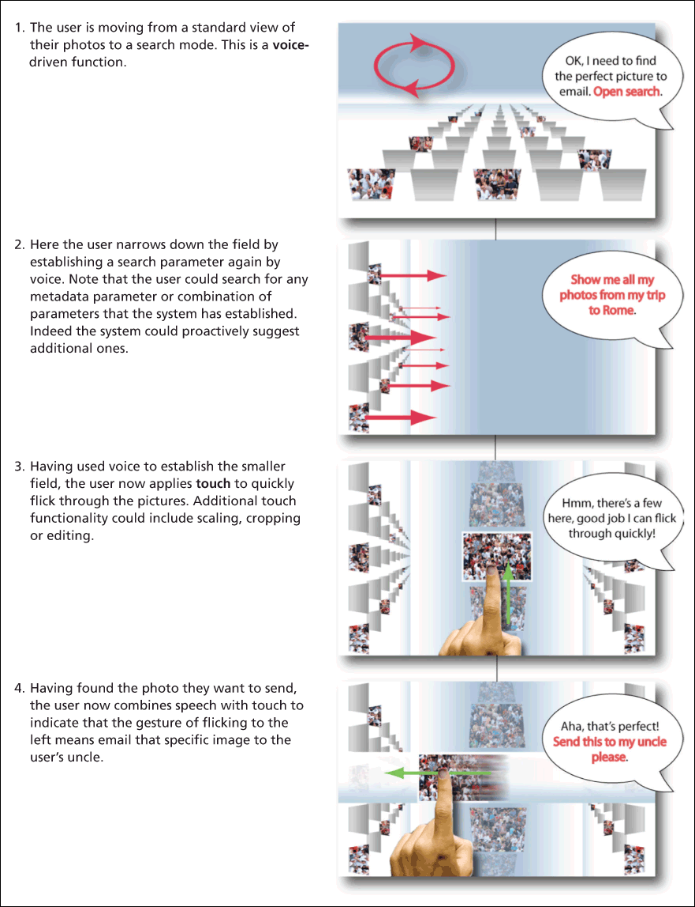
Notes:
Figure 3.8 A scenario of multimodal interaction with a photo companion that we called PhotoPal

Slide 46
Environment
In another scenario, we were looking at environmental influence on the interaction.
Small displays (e.g. digital photo frames) have a more limited touch capability than a larger display.
Using a display that is simply too far from the person to be touched.
This in many ways most fairly reflect the current living room environment.
In such a situation, physical gesture becomes an appropriate option, either by using ones hands or by wielding an object, such as is used in the Nintendo Wii games console.
This allows for parameters such as speed, direction and shape of movement.

Slide 47
Using scenarios throughout design
Scenarios (and their associated personas) are a core technique for interactive systems design.
They are useful in understanding, envisioning, evaluation and both conceptual and physical design: the four key stages of interactive system design.
We distinguish four different types of scenario: stories, conceptual scenarios, concrete scenarios and use cases.
Stories are the real-world experiences of people.
Conceptual scenarios are more abstract descriptions in which some details have been stripped away.
Concrete scenarios are generated from abstract scenarios by adding specific design decisions and technologies and once completed these can be represented as use cases.
Use cases are formal descriptions that can be given to programmers.

Slide 48
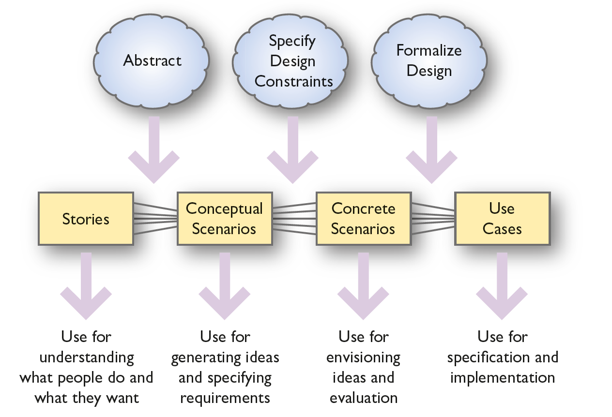
Scenarios throughout design

Slide 49
Scenarios at different stages
At different stages of the design process, scenarios are helpful in understanding current practice and any problems or difficulties that people may be having, in generating and testing ideas, in documenting and communicating ideas to others and in evaluating designs.
Many stories will be represented by a few conceptual scenarios. However, each conceptual scenario may generate many concrete scenarios.
Several concrete scenarios will be represented by a single use case.
Designers abstract from the details of stories to arrive at conceptual scenarios.
They specify design constraints on conceptual scenarios to arrive at concrete scenarios.
Finally, they formalize the design ideas as use cases.

Slide 50
Stories
Stories are the real-world experiences, ideas, anecdotes and knowledge of people.
These may be captured in any form and comprise small snippets of activities and the contexts in which they occur.
This could include videos of people engaged in an activity, diary entries, photographs, documents, the results of observations and interviews and so on.
People’s stories are rich in context.
Stories also capture many seemingly trivial details that are usually left out if people are asked to provide more formal representations of what they do.

Slide 51
Story: Example
I needed to make an appointment for Kirsty, my little one. It wasn’t urgent – she had been having a lot of bad earache every time she had a cold – but I did want to see Dr Fox since she’s so good with the children. And of course ideally it had to be when Kirsty was out of school and I could take time off work. I rang the surgery and the receptionist told me that the next appointment for Dr Fox was the next Tuesday afternoon. That was no good since Tuesday is one of my really busy days so I asked when the next one was. The receptionist said Thursday morning. That meant making Kirsty late for school but I agreed because they sounded very busy – the other phone kept ringing in the background – and I was in a hurry myself. It was difficult to suggest a better time without knowing which appointments were still free.

Slide 52
Conceptual scenarios
Conceptual scenarios are more abstract than stories.
Much of the context is stripped away during the process of abstraction and similar stories are combined together.
Conceptual scenarios are particularly useful for generating design ideas and for understanding the requirements of the system.
Once the designer has accumulated a collection of stories, common elements will start to emerge.
In this case, a number of stories such as the one above result in the conceptual scenario below describing some requirements for a computerized appointments system.

Slide 53
Abstraction
The process of abstraction is one of the classifications and aggregations: moving from the details of specific people undertaking specific activities in a specific context using a particular piece of technology to a more general description that still manages to catch the essence of the activity.
Aggregation is the process of treating a whole thing as a single entity rather than looking at the components of something.
In most domains, for example, one would aggregate a screen, processor, disc drive, keyboard and mouse and treat this as a single thing – a computer – rather than focusing on the components.
Classification is the process of recognizing that things can be collected together so that dealing with the class of things is simpler (more abstract) than dealing with the individual things.
There are no set ways to classify things, so the analyst has to work with the stories that have been gathered and with the users themselves to decide which things belong together and why.
Between them aggregation and classification produce abstractions.
Of course, there are different degrees of abstraction and it is one of the skills of a designer to settle upon an appropriate level.
The most abstract level is to treat everything simply as a ‘thing’ and every activity as ‘doing something’ but such an abstract representation is not usually very useful.

Slide 54
Degrees of abstraction
Example: Booking an appointment: People with any degree of basic computer skills will be able to contact the doctors’ surgery at any time via the internet and see the times which are free for each doctor. They can book a time and receive confirmation of the appointment.
As you can see, at this stage, there is little or no specification of precise technologies or how the functions will be provided.
The scenario could be made more abstract by not specifying that the internet should be used or more concrete (that is less abstract) by specifying that the booking should be made from a computer rather than a mobile phone.
Finding an appropriate level of abstraction at which to describe things for a given purpose is a key skill of the designer.

Slide 55
Concrete scenarios
Each conceptual scenario may generate lots of concrete scenarios.
When designers are working on a particular problem or issue, they will often identify some feature that applies only under certain circumstances.
At this point, they may develop a more specific elaboration of the scenario and link it to the original.
Thus, one reasonably abstract scenario may spawn several more concrete elaborations which are useful for exploring particular issues.
Notes can be added to scenarios that draw attention to possible design features and problems.
Concrete scenarios also begin to dictate a particular interface design and a particular allocation of functions between people and devices.
Concrete scenarios are particularly useful for prototyping and envisioning design ideas and for evaluation because they are more prescriptive about some aspects of the technology.
However, there is not a clean break between conceptual and concrete scenarios.
The more specific the scenario is about some aspects, the more concrete it is.

Slide 56
Concrete scenarios: Example
In the example below, decisions have now been taken concerning drop-down menus, the fact that the next two weeks’ details are to be shown and so on. However, the notes following the scenario show that there are many design decisions still to be taken.
Booking an appointment/01:
Andy Dalreach needs a doctor’s appointment for his young daughter Kirsty in the next week or so. The appointment needs to be outside school time and Andy’s core working hours, and ideally with Dr Fox, who is the children’s specialist. Andy uses a PC and the internet at work so has no difficulty in running up the appointments booking system. He logs in [1] and from a series of drop-down boxes chooses to have free times for Dr Fox [2] displayed for the next two weeks [the scenario would continue to describe how Andy books the appointment and receives confirmation].
Notes to booking an appointment/01:
Is logging in necessary? Probably, to discourage bogus access to the system but check with the surgery, logging is necessary.
Free times can be organized by doctor, by time of day or by the next available time. Drop-down boxes will save screen space but may present problems for less experienced users or those with poor eyesight.

Slide 57
Use cases
A use case describes the interaction between people (or other ‘actors’) and devices.
It is a case of how the system is used and hence needs to describe what people do and what the system does.
Each use case covers many slight variations in circumstances – many concrete scenarios.
Before use cases can be specified, tasks and functions have to be allocated to humans or to the device.
The specification of use cases both informs and is informed by the task/function allocation process.
A set of use cases can be produced which specify the complete functionality of the system and the interactions that will occur.
There are a number of different ways of representing use cases – from very abstract diagrams to detailed ‘pseudo code’.

Slide 58
A scenario-based design method
The use of the different types of scenarios throughout design can be formalized into a scenario-based design method.
Besides the four different types of scenario, four other artefacts are produced during the design process:
Requirements/Problems
Scenario corpus
Object model
Design language.
The specification of a system is the combination of all the different products produced during the development process.

Slide 59
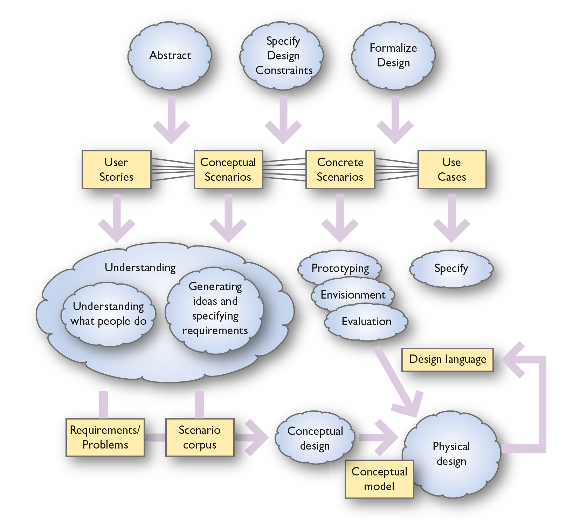
A scenario-based design method
Clouds are processes
Boxes are things produced
Notes:
Figure 3.13 Overall scenario-based design method

Slide 60
Scenarios through design
An important thing to notice is the relationship between specifying design constraints and the use of scenarios.
For envisionment and most evaluation, the scenarios have to be made more concrete.
This means imposing design constraints.
However, this does not mean that the designer needs to design a new physical, concrete scenario each time he or she wants to envision a possible design.
It may be that designers imagine a scenario with particular design constraints imposed and this helps them evaluate the design.
This sort of ‘what if?’ generation and evaluation of concrete scenarios is a common and key aspect of design.

Slide 61
Requirements and problems
In the gathering of people’s stories and during the analysis and abstraction process, various issues and difficulties will come to light.
These help the analyst/designer to establish a list of requirements – qualities or functions that any new product or system should have.
For example, in the HIC example, the device has to be used by the elderly and short-sighted.
Another requirement was that it should look good in a living room and should not look or behave like a personal computer running Microsoft Windows.
The format of the requirements and problems is a prioritized list of issues, or a more formalized format.

Slide 62
Scenario corpus
In our approach, we seek to develop a representative and carefully thought-through set, or corpus, of scenarios.
Having undertaken some analysis activities, designers will have gathered a wide range of user stories.
Some of these will be very general and some will be quite specific.
Some will be fairly simple, straightforward tasks; others will be more vague.
It is important at some point for the designer to pull these disparate experiences together in order to get a high-level, abstract view of the main activities that the product is to support.
These conceptual scenarios will often still be grounded in a real example; the trick is to find an example that shares characteristics with a number of other activities.

Slide 63
Domain characteristics
The rationale for the development of a corpus of scenarios is to uncover the ‘dimensions’ of the design situation and to demonstrate different aspects of those dimensions.
Dimensions include characteristics of the various domains within which the product will operate (e.g. large and small domains, volatile or static domains and so on), the various media and data types that need to be accommodated and the characteristics of the people who will be using the system.
The corpus of scenarios needs to cover all the main functions of the system and the events that trigger the functions.
Different types of interaction need to be present along with any key usability issues.
The dimensions include different types of content and how that can be structured, issues of style and aesthetics.
The aim is to specify the scenarios at a level of abstraction that captures an appropriate level of generality that will be useful across the range of characteristics that is demonstrated within a domain.

Slide 64
Conceptual model
An object or data model results from the process of conceptual modeling, including developing the scenarios and undertaking an object/action analysis of the scenario corpus.
The conceptual model shows the main objects in the system, their attributes and the relationships that exist between them.
Conceptual modeling is a very important part of interactive systems design that is often overlooked.
Having a clear, well-designed conceptual model will make it easier to design so that people can develop a good, accurate mental model of the system.
The conceptual model will also form the basis of the information architecture of a system and for any metaphor that is used in the design.
Two famous conceptual models are the concept of the spreadsheet and the various objects such as printers, folders, documents, etc. that make up the ‘desktop’ metaphor of the Windows and Mac OS operating systems.

Slide 65
Design language
The design language produced consists of a set of standard patterns of interaction and all the physical attributes of a design – the colours, shapes, icons and so on.
These are brought together with the conceptual actions and objects and the ‘look and feel’ of the design is completed.
A ‘design language’ defines the key elements of the design (such as the use of colour, style and types of buttons, sliders and other widgets and so on) and some principles and rules for putting them together.
A consistent design language means that users need to learn only a limited number of design elements and then they can cope with a large variety of different situations.

Slide 66
Documenting scenarios
Scenarios can become messy, so in order to control the scenarios, a structure is needed.
We use the PACT framework (people, activities, contexts, technologies) to critique scenarios and to encourage designers to get a good description of the scenario.
For each scenario, the designer lists the different people who are involved, the activities they are undertaking, the contexts of those activities and the technologies that are being used.
We also structure scenario descriptions. Each scenario should be given an introduction.
The history and authorship can be recorded, along with a description of how the scenario generalizes (across which domains) and the rationale for the scenario.
Each paragraph of each scenario should be numbered for ease of reference and endnotes included where particular design issues are raised.
Endnotes are particularly useful in documenting issues raised during the development of the scenario. They are a way of capturing the claims being made about the scenarios.
Examples of relevant data and media should be collected.

Slide 67
Trade-offs
Rosson and Carroll (2002) describe an approach to scenario-based design in which scenarios are used throughout the design process and how they help designers to justify the claims that they make about design issues.
Design is characterized by trade-offs.
There is rarely a simple solution to a problem that solves all the issues.
Usually the adoption of one design will mean that something else cannot be achieved.
Designers need to document their design decisions so that the trade-offs can be evaluated.
Scenarios help by making the rationale for the design explicit.
Designers can record the claims that they make about their designs.

Slide 68
Claims analysis
Claims analysis is an important part of scenario-based design and is used in identifying problems or in thinking through possible future designs (Rosson and Carroll, 2002).
The process is simply to identify key features of a scenario and to list good and bad aspects of the design.
Rosson and Carroll use a technique of putting a ‘+’ beside good features and a ‘−’ beside bad features.
Claims analysis makes the rationale behind a design explicit.
A similar method is to list the design Questions, design Options and Criteria used to make choices, the QOC method.

Slide 69
Gathering data
When working in a large design team, it is useful to accompany scenarios by real data.
This means that different team members can share concrete examples and use these as a focus of discussion.
Another key feature of writing scenarios is to think hard about the assumptions that are being made: to make assumptions explicit or deliberately avoid making things explicit in order to provoke debate.
In particular, the use of personas can help focus on specific issues.
For example, an elderly woman with arthritis might be one of the personas, thus foregrounding issues of access and the physically impaired interacting with technology.
Finally, with these scenarios, it is important to provide a very rich context.
The guiding principles for scenario writing are people, activities, contexts and technologies.
The following example is grounded in a concrete example and in a specific context; this is still quite conceptual in that it is used to generate ideas and designs.

Slide 70
Using scenarios example: A home information centre (HIC) (1 of 2)
P1. Anne is a freelance arts journalist who works mainly from home. She’s writing a piece for a national newspaper about singer-songwriters and is irritated to find she can’t remember the lyrics of a particular well-known song she wants to quote in her article. She knows the name of the singer and the song title, but beyond that, her memory is failing her.
P2. She leaves her desk, hoping a break and a cup of coffee will dispel the block. While in the kitchen, she decides she’ll check the HIC for new messages [1]. While she is doing this, she realizes that the HIC’s MP3 player [2] can help her out.
She remembers she has downloaded the song [3] she needs at some time in the past two months or so and knows it’s still in the HIC’s memory [4].

Slide 71
Using scenarios example: A home information centre (HIC) (2 of 2)
Notes to scenario MP3/01:
Checking messages is peripheral to the MP3 domain but it is interesting to consider how MP3-related activities fit in with other domains of the HIC. Multiple screen objects will soon start to compete with each other for screen space.
‘MP3 player’ is meant here in the general sense of the MP3 domain – that is, all the functions relating to MP3.
How she has done this is not described here – but see scenario MP3/02 for a more detailed account of this activity.
The question of how the HIC stores MP3 and other files is a significant one. One of the popular features of the MP3 format is the ease with which files can be shuffled from one platform to another; this will involve frequent use of saving, copying, deleting and other functions. This may imply the need for some sort of ‘File Manager’ function in the HIC (cf. scenarios MP3/02, /03, /04).

Slide 72
Cross-referencing scenario types
Another aspect of documentation that is useful is to cross-reference the stories to the conceptual scenarios, through the concrete examples and finally to the use cases.
A simple Web-based system can be developed.
Other researchers have suggested similar ideas that capture the multiple views necessary to see how scenarios and claims work together to provide a rich understanding of how a design finished as it did.

Slide 73
Summary
The design of interactive systems is concerned with people, the activities they are undertaking, the contexts of those activities and the technologies that are used.
This presentation has introduced the main elements of design – understanding, envisionment, design and evaluation and how scenario-based design and the development of personas can be used to guide the designer.
Scenarios and their different uses in this process have been explored.
Scenarios are stories about the interactions amongst people, activities, contexts and technologies.
Scenarios offer an effective way of exploring and representing activities, enabling the designer to generate ideas, consider solutions and communicate with others.
Scenarios are used throughout the design process and, as use cases, form part of the formal specification of the system.

